Slide 1
Programming Language Implementation /
Cadence Implementation

Slide 2
Programming Language
Implementation

Slide 3
Source Code
Phases
Input is a program in text form
On a high level there are 3 phases
Each phase transforms and/or generates more information
These phases are often sequential (as separate passes), but can be performed together (in one pass)
Trade-off:
complexity/features vs performance
Syntactical Analysis
(“Parsing”)
Semantical Analysis
(“Checking”)
Evaluation
(“Execution”)

Slide 4
Syntactical Analysis

Slide 5
Source Code
Syntactical Analysis
Input is a program in text form (characters)
Characters
Lexical Analysis
(“Lexing”, “Tokenization”)
Tokens
Parsing
Syntax Tree

Slide 6
Source Code
Syntactical Analysis
First, the characters are split into tokens,
e.g. “fun foo() { return }”:
  Keyword “fun”
  Identifier “foo”
  Open paren
  Close paren
  Open brace
  Keyword “return”
  Close brace
Characters
Lexical Analysis
(“Lexing”, “Tokenization”)
Tokens
Parsing
Syntax Tree

Slide 7
Source Code
Syntactical Analysis
The parser validates that the source code has a valid form, which is defined
in a grammar (rules)
For example, a function declaration:
  Must start with the “fun” keyword
  Must follow with an identifier,
  the name
  Must follow with an open paren
  Must follow with
  parameters (nested rule)
  ...
Characters
Lexical Analysis
(“Lexing”, “Tokenization”)
Tokens
Parsing
Syntax Tree

Slide 8
Source Code
Syntactical Analysis
If the program is invalid,
i.e. the tokens don’t follow the grammar,
then errors are reported
The parser ideally recovers from problems and parses the remainder
Characters
Lexical Analysis
(“Lexing”, “Tokenization”)
Tokens
Parsing
Syntax Tree

Slide 9
Source Code
Syntactical Analysis
Then the tokens are transformed into a syntax tree, e.g.
Characters
Program
Declarations:
Lexical Analysis
(“Lexing”, “Tokenization”)
Tokens
Function Declaration
Name: “foo”
Body:
Parsing
Return Statement
Syntax Tree

Slide 10
Source Code
Syntactical Analysis
The syntax tree might be
concrete or abstract
A concrete syntax tree is shaped in the form of the grammar rules
An abstract syntax tree is shaped for the semantical analysis and execution
Some syntactical analysis phases may have both, some just one
Characters
Lexical Analysis
(“Lexing”, “Tokenization”)
Tokens
Parsing
Syntax Tree

Slide 11
Semantical Analysis

Slide 12
Semantical Analysis
Syntax Tree
Input is a syntax tree
Produces an elaboration:
Information about the program
For example, resulting type of an expression like “a + 1”
Semantical Analysis
Syntax Tree + Elaboration

Slide 13
Semantical Analysis
Syntax Tree
Scoping: Regions where declarations are valid
Determines (infers) types and validates typing rules (subtyping)
Semantical Analysis
Syntax Tree + Elaboration

Slide 14
Semantical Analysis
Syntax Tree
Checks that the program is valid,
which is defined in the semantics (rules)
For example, a rule might be
“+ is only defined for numbers”
Given a variable “a” of type “String”,
a program “a + 1” is invalid
Semantical Analysis
Syntax Tree + Elaboration

Slide 15
Evaluation

Slide 16
Evaluation
Programs can be executed in different ways:
  Interpretation
  Compilation
  A mix of both, e.g.
    Compiling while interpreting: “Just-in-time compilation”
    Compiling to a non-native instruction set
    (e.g. JVM, WebAssembly, etc.),
    then interpreting the binary

Slide 17
Evaluation
How a program is executed is not defined by the language!
  For example, C is not a “compiled language”:
  there are many C compilers, but also interpreters!
There might be many implementations of a language:
  Python: CPython (reference), PyPy, Jython, IronPython, etc.
  Ruby: Ruby MRI (reference), Mruby, JRuby, IronRuby, etc.
  C: GCC, Clang, CINT, etc.
  JavaScript: V8, SpiderMonkey, JavaScriptCore, etc.

Slide 18
Evaluation
Interpretation:
  Input is AST and elaboration, or program of “flat” instructions
  Program that executes the input program
  For example:
  If an AST element or an instruction in the program represents addition,
  then the interpreter performs the addition

Slide 19
Evaluation
Compilation:
  Input is AST and elaboration
  Output is binary of “flat” instructions,
  which can usually be run by a CPU
  Might perform optimizations:
    For example, the code “1 + 2” might be directly evaluated
    at compile time, once, so the addition does not has to be performed each time the program is executed
    Dead code might be removed

Slide 20
Evaluation
Trade-off: Time to execution vs execution time
  For example, if a program is run many times,
  it makes sense to spend more time upfront, once,
  to reduce the execution time
  If a program is only run once,
  compilation time might be longer than total execution time

Slide 21
Cadence

Slide 22
Phases
Programs are uploaded to the chain as source code
(deployed contracts, transactions, scripts)
Execution:
  Parse (syntactical analysis)
  Check (semantic analysis)
  Interpret
Optional caching of parsed programs
Checking result is elaboration (types of AST nodes)
AST and elaboration are not stored on-chain

Slide 23
Source Code
Transaction
Blockchain Runtime
(Parse + Check + Interpret)

Slide 24
Source Code
Transaction
Blockchain Runtime
(Parse + Check + Interpret)

Slide 25
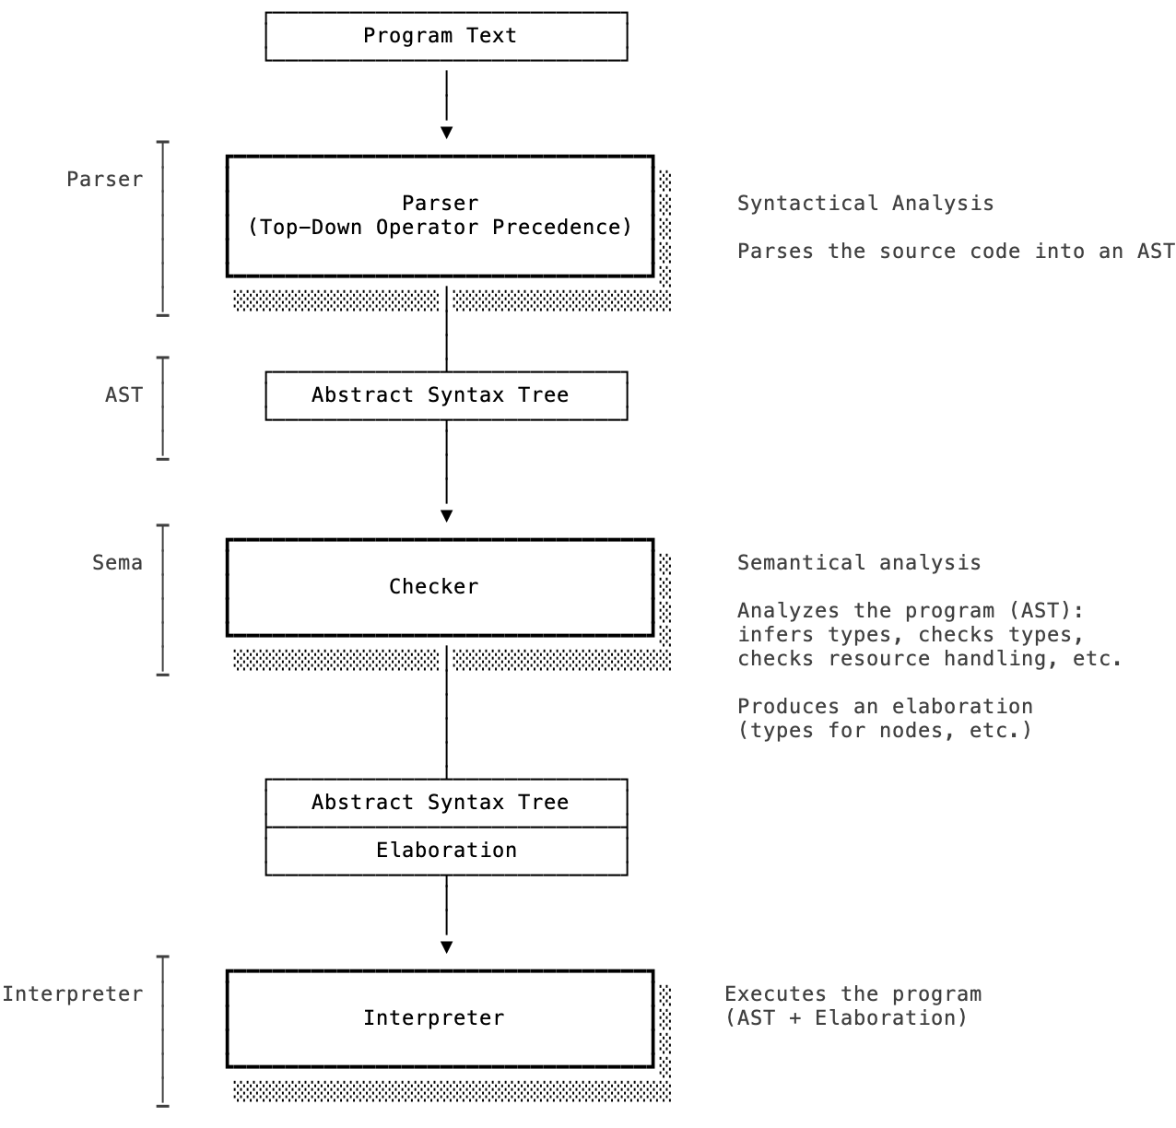

Slide 26
Parsing
Concurrent tokenization (goroutine)
Produces AST directly, no CST

Slide 27
Parsing
Parser was initially generated using ANTLR
  Pros:
    Nice declarative grammar
    Development speed
  Cons:
    Go backend is very slow
    Hard to handle parse errors
    Hard to handle ambiguities
    Easy to introduce exponential blow-up
    Construction of CST is additional step with associated overhead
Replaced with hand-written Top-Down Operator Precedence (Pratt) parser

Slide 28
Checking
Checks:
  Type checks (e.g. subtyping, restrictions, etc.)
  Resource tracking (construction, moves, destroys)
  Interface conformance
  Type requirement conformance
  Definite initialization / use-before initialization
  Literal range checks
  Type storability
Based on visitor over AST
  Breadth-first traversal: use before declaration

Slide 29
Execution
AST-walking interpreter, uses visitor

Slide 30
Tools
Language Server + Visual Studio Code extension
  Implements Language Server Protocol
  Integrated into CLI
  Integrated into Playground FE using WebAssembly
REPL
  Useful for development of Cadence
  Would be nice to integrate it with emulator/network:
  re-use language server
Documentation generator
Debugger

Slide 31
Tools
Command-line tools for parsing, checking, executing
  Allow benchmarking
Compatibility suite:
  Checks out known repositories
  Generates report about parsing/checking and performance regressions

Slide 32
Integration with Flow
“Runtime” interface
  Import handling (resolution, reading code)
  Storage: read value, write value
  Account management:
    Account creation
    Key management
    Contract management
  Event emission
  Transaction information (signers)
  Block information
  Crypto (hashing, signature verification, etc.)
  Random number generation

Slide 33
K Semantics
We started with formalizing Cadence using the K Framework
Subset of early version of Cadence (e.g., no resources)
Declare syntax and semantics → generate interpreter, verifier, etc.
“Correct by construction”
Experience:
  Requires lots of expert knowledge
  Time consuming
  Slow iteration
Assumed we could use it as a tool for language design exploration
Language better defined now, it would be nice to complete this eventually

Slide 34
Performance and Efficiency: Execution
Replace interpreter with compiler and virtual machine
Compiler could initially be just used on-chain (to increase performance)
By adding a bytecode verifier and using it on-chain,
users could run compiler off-chain and submit compiled bytecode,
the network wouldn’t need to compile
Bytecode verifier and Virtual Machine must enforce
same security and safety semantics for bytecode
as checker and interpreter do for Cadence source programs

Slide 35
Source Code
Compiler
Bytecode
Transaction
Blockchain Runtime
(Verify + Execute)

Slide 36
Source Code
Compiler
Bytecode
Transaction
Blockchain Runtime
(Verify + Execute)

Slide 37
Performance and Efficiency: Execution
Requirements:
  Deterministic (e.g. cannot have non-deterministic features like platform-dependent floating point semantics)
  Portable
  “Managed”: Instruction set must not allow direct access to private data
  Size-efficient
  Linear types / resource semantics
  Similar to JVM/CL

Slide 38
Performance and Efficiency: Execution
Requirements:
  Deterministic (e.g. cannot have non-deterministic features like platform-dependent floating point semantics)
  Portable
  “Managed”: Instruction set must not allow direct access to private data
  Size-efficient
  Linear types / resource semantics
  Similar to JVM/CL

Slide 39
Performance and Efficiency: Execution
Options
  WebAssembly
    Has external references/values
    Standard
    Many implementations and lots of tooling
    Formal semantics
    Is missing linear types
    Need to extend instruction set
  (Cont.)

Slide 40
Performance and Efficiency: Execution
Options (continued)
  MoveVM
    Has linear types
    Is missing external references/values
    Only one implementation
    Need to extend instruction set and virtual machine
    Opposition to extension, e.g. with dynamic features
  (Cont.)

Slide 41
Performance and Efficiency: Execution
Options (continued)
  LLVM IR:
    Not portable: architecture specific
    Generates very efficient code
    Slow compilation speed
  Custom?
    Lots of work and re-inventing the wheel
    Source of bugs

Slide 42
Performance and Efficiency: Execution
Currently we have
  WebAssembly Binary (WASM) reader/writer
  Start of IR
  Start of compiler
Goal is to have MVP
  Compiler and verifier for subset (e.g resources, interfaces)
  Demonstrate approach satisfies goals

Slide 43
Performance and Efficiency: Storage
Storage operations account for a large portion of execution
Programs are read/write heavy, usually not compute intensive
Storage format: CBOR
  RFC standard
  Efficient
Streaming decoding and encoding (no intermediate objects)
Lazy decoding (read data, only decode when/if needed)

Slide 44
Reliability
Bugs: crashers, security issues (!)
Known problems
  Manually written tests
Unknown problems
  Automatic testing: Fuzzing

Slide 45
Questions?

